Slide 1
React.js
Course: CSC 436 Web Applications Instructor: Paul Duszak
Quarter: Fall 2022

Slide 2
Express Continued

Slide 3
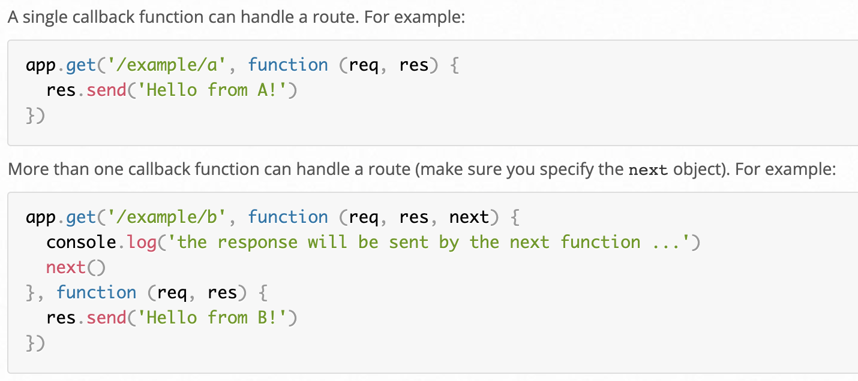
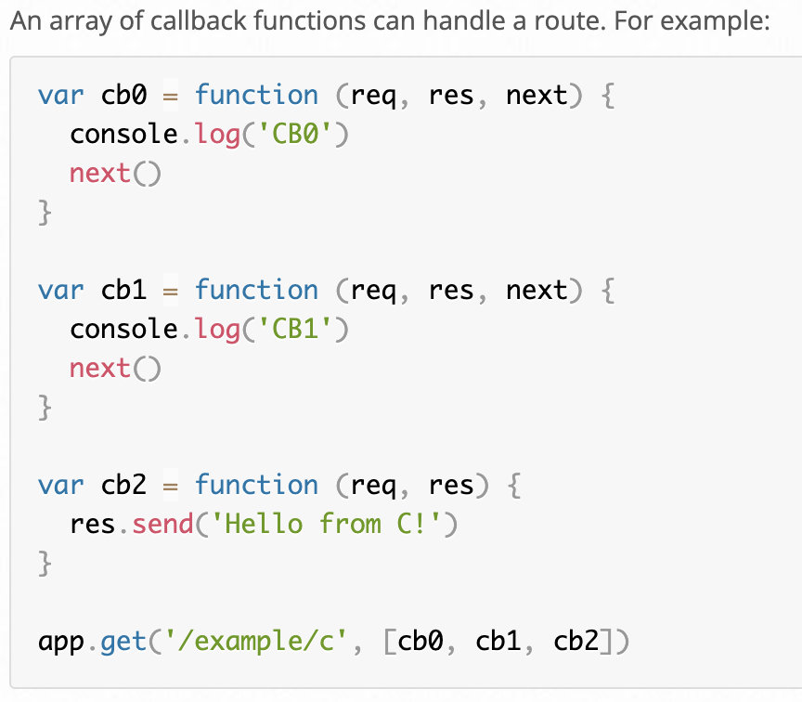
Route Handlers
You can provide multiple callback functions that behave like middleware to handle a request. The only exception is that these callbacks might invoke next('route') to bypass the remaining route callbacks. You can use this mechanism to impose pre-conditions on a route, then pass control to subsequent routes if there’s no reason to proceed with the current route.
Route handlers can be in the form of a function, an array of functions, or combinations of both, as shown in the following examples.

Slide 4
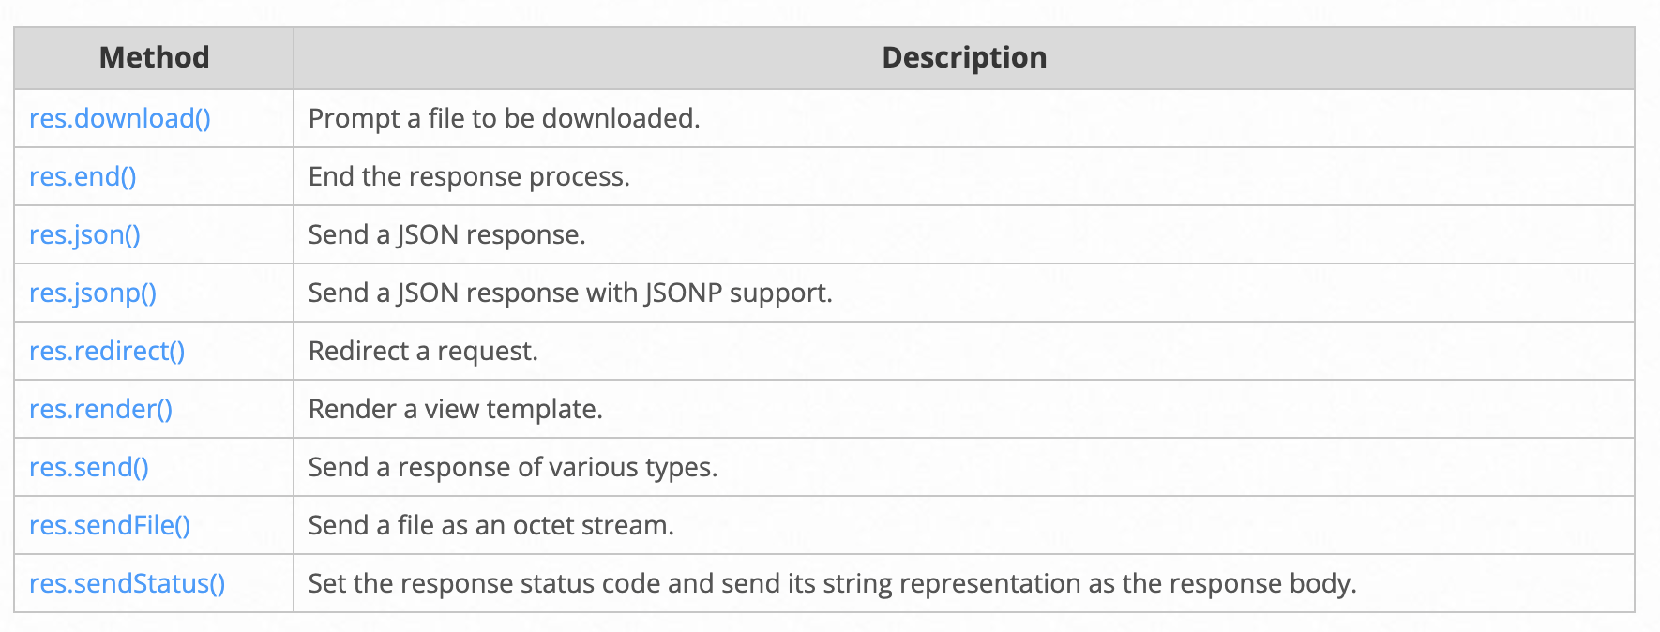
Route Response Methods
The methods on the response object (res) in the following table can send a response to the client and terminate the request-response cycle. If none of these methods are called from a route handler, the client request will be left hanging.

Slide 5
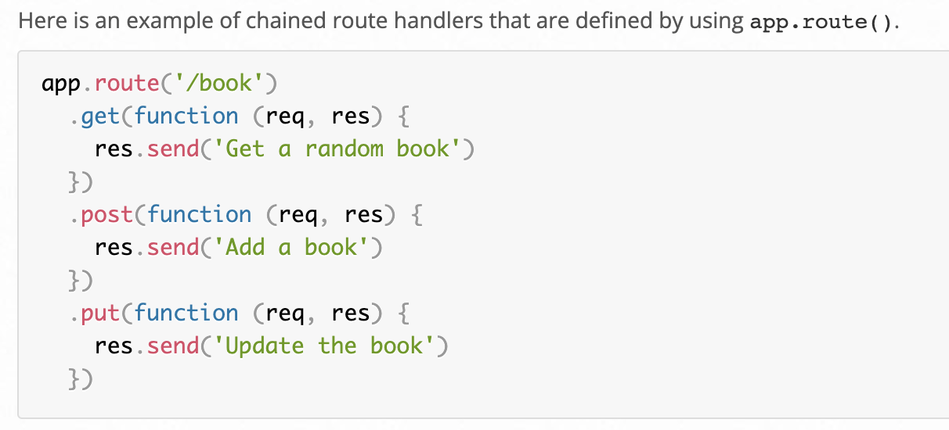
app.route()
You can create chainable route handlers for a route path by using app.route(). Because the path is specified at a single location, creating modular routes is helpful, as is reducing redundancy and typos

Slide 6
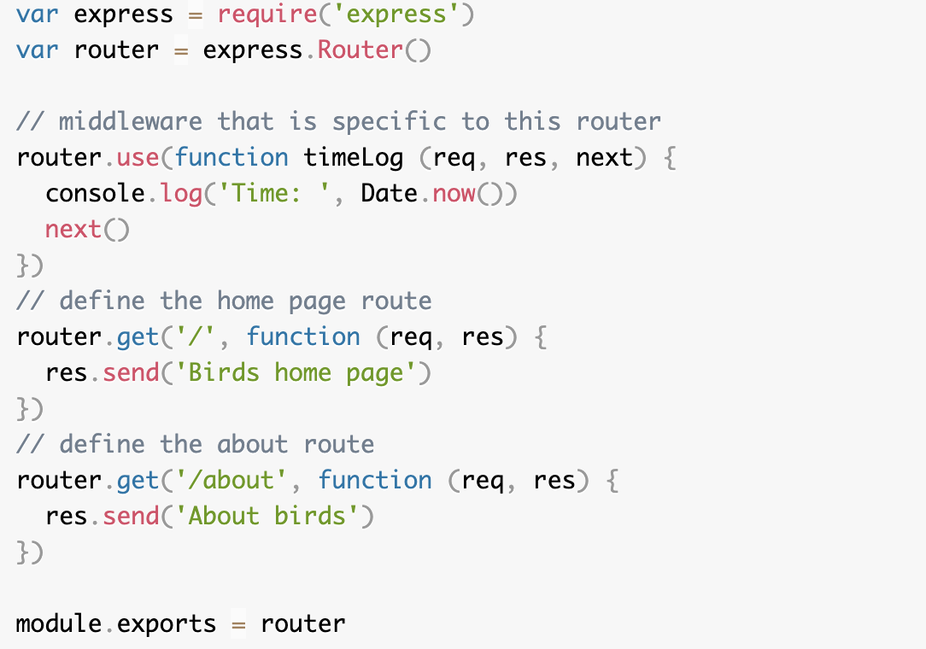
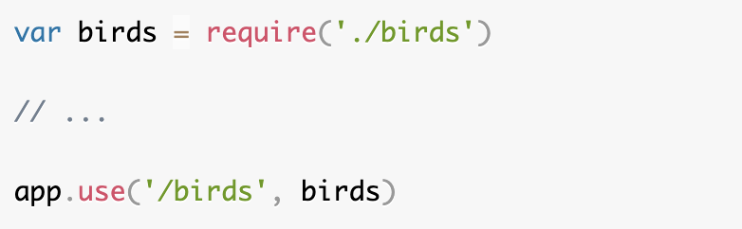
express.Router
Use the express.Router class to create modular, mountable route handlers. A Router instance is a complete middleware and routing system; for this reason, it is often referred to as a “mini-app”.
The following example creates a router as a module, loads a middleware function in it, defines some routes, and mounts the router module on a path in the main app.
birds.js:
app.js

Slide 7
Middleware
Functions that have access to the request object (req), the response object (res), and the next function in the application’s request-response cycle. The next function is a function in the Express router which, when invoked, executes the middleware succeeding the current middleware. Middleware functions can perform the following tasks:
Execute any code.
Make changes to the request and the response objects.
End the request-response cycle.
Call the next middleware in the stack.
If the current middleware function does not end the request-response cycle, it must call next() to pass control to the next middleware function. Otherwise, the request will be left hanging.

Slide 8
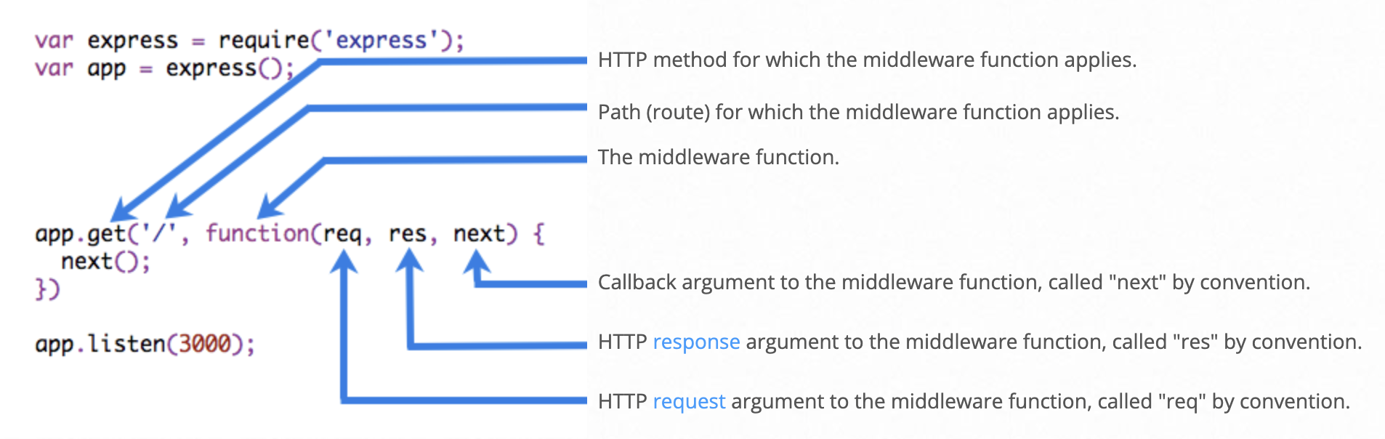
Elements of a Middleware Function

Slide 9
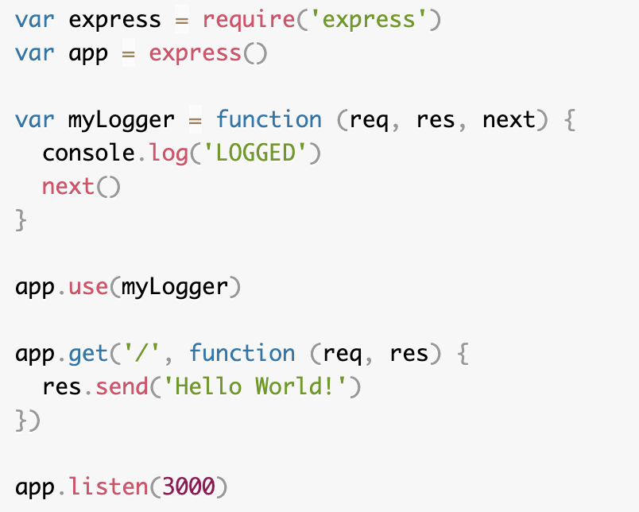
Middleware Example - Logging
Here is a simple example of a middleware function called “myLogger”. This function just prints “LOGGED” when a request to the app passes through it. The middleware function is assigned to a variable named myLogger.

Slide 10
Middleware Example - Logging
Here is a simple example of a middleware function called “myLogger”. This function just prints “LOGGED” when a request to the app passes through it. The middleware function is assigned to a variable named myLogger.
To load the middleware function, call app.use(), specifying the middleware function. For example, the following code loads the myLogger middleware function before the route to the root path (/).
The order of middleware loading is important: middleware functions that are loaded first are also executed first.
If myLogger is loaded after the route to the root path, the request never reaches it and the app doesn’t print “LOGGED”, because the route handler of the root path terminates the request-response cycle.
The middleware function myLogger simply prints a message, then passes on the request to the next middleware function in the stack by calling the next() function.

Slide 11
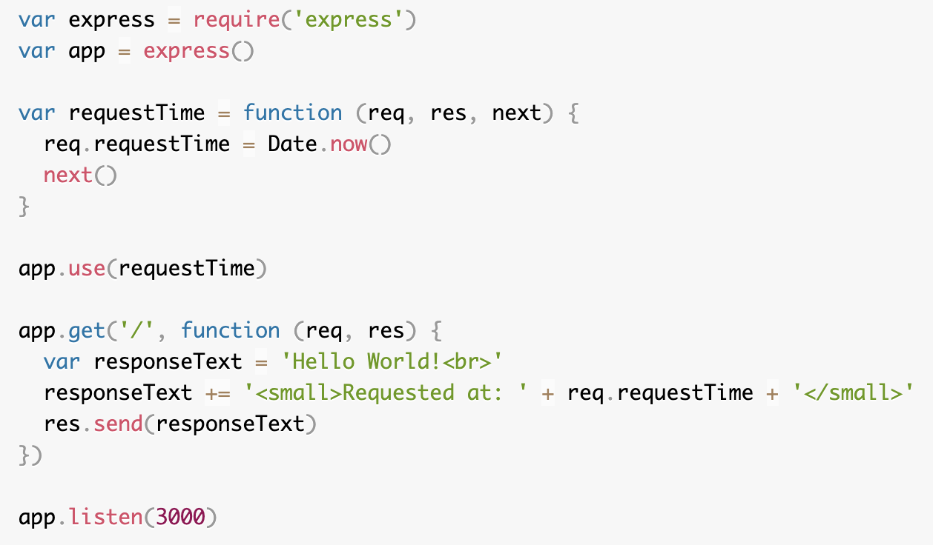
Middleware Example - requestTime
Below is an example of middleware which adds a requestTime property to each request.
To load the middleware function, call app.use(), specifying the middleware function. For example, the following code loads the myLogger middleware function before the route to the root path (/).
The order of middleware loading is important: middleware functions that are loaded first are also executed first.
If myLogger is loaded after the route to the root path, the request never reaches it and the app doesn’t print “LOGGED”, because the route handler of the root path terminates the request-response cycle.
The middleware function myLogger simply prints a message, then passes on the request to the next middleware function in the stack by calling the next() function.

Slide 12
Types of Middleware
An Express application can use the following types of middleware:
Application-level middleware
Router-level middleware
Error-handling middleware
Built-in middleware
Third-party middleware
You can load application-level and router-level middleware with an optional mount path. You can also load a series of middleware functions together, which creates a sub-stack of the middleware system at a mount point.

Slide 13
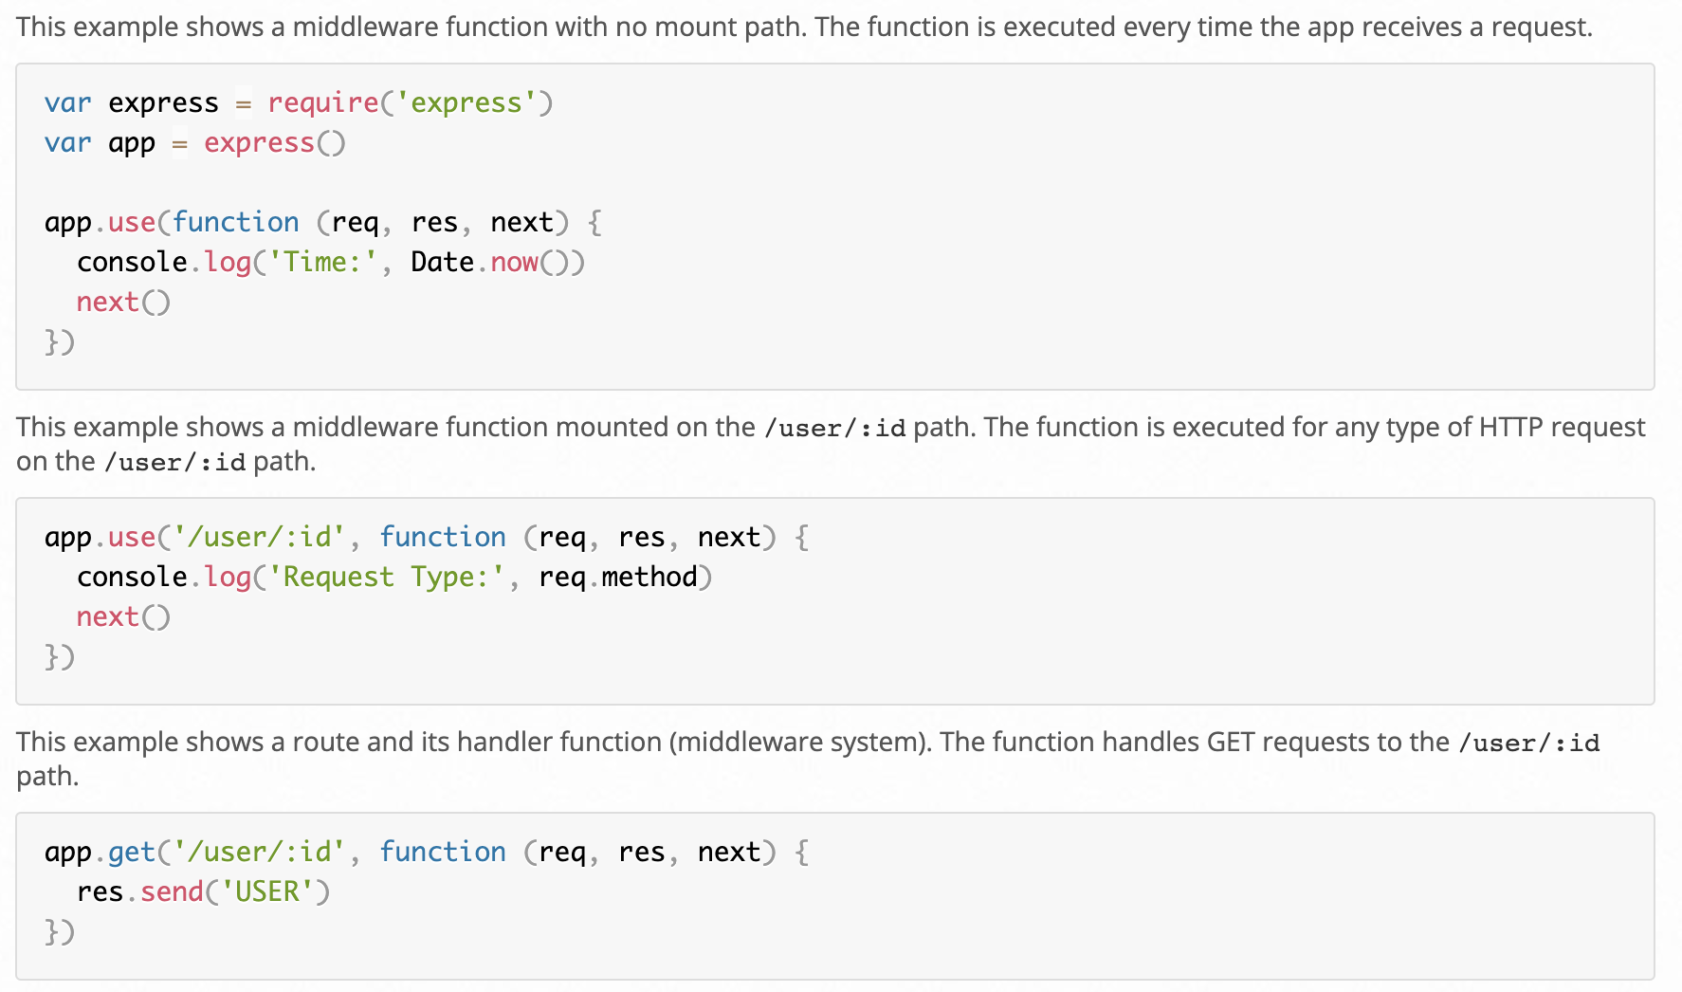
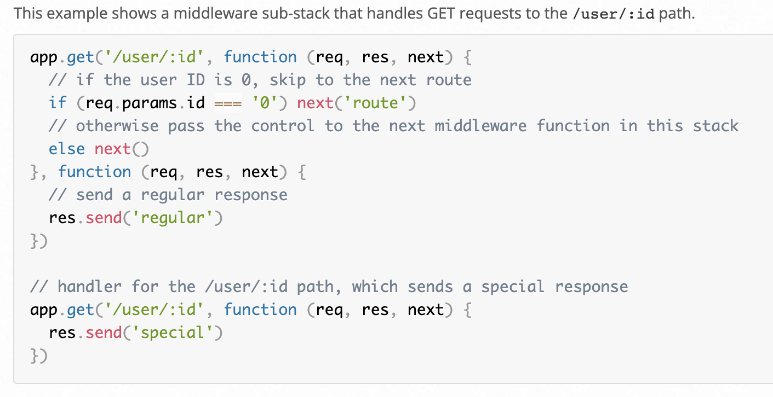
Application-level Middleware
Bind application-level middleware to an instance of the app object by using the app.use() and app.METHOD() functions, where METHOD is the HTTP method of the request that the middleware function handles (such as GET, PUT, or POST) in lowercase.

Slide 14
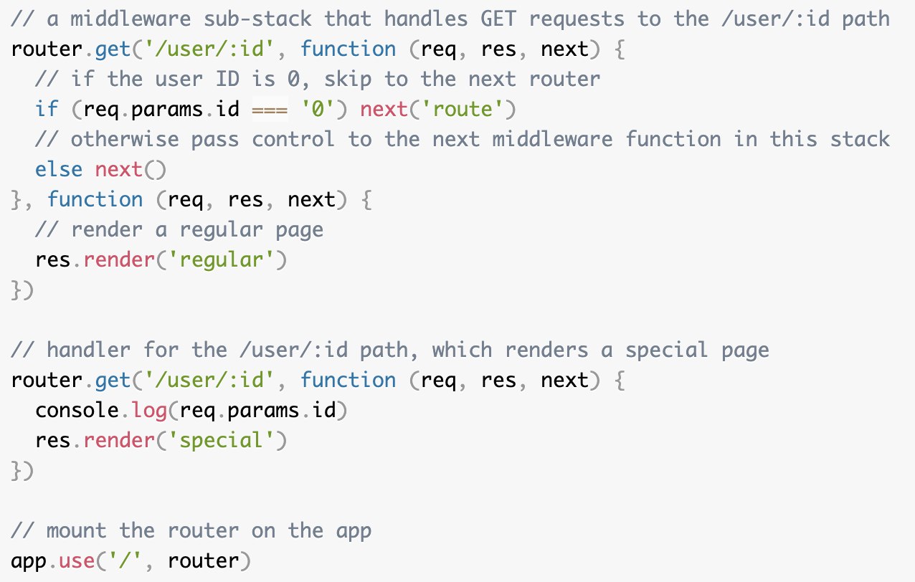
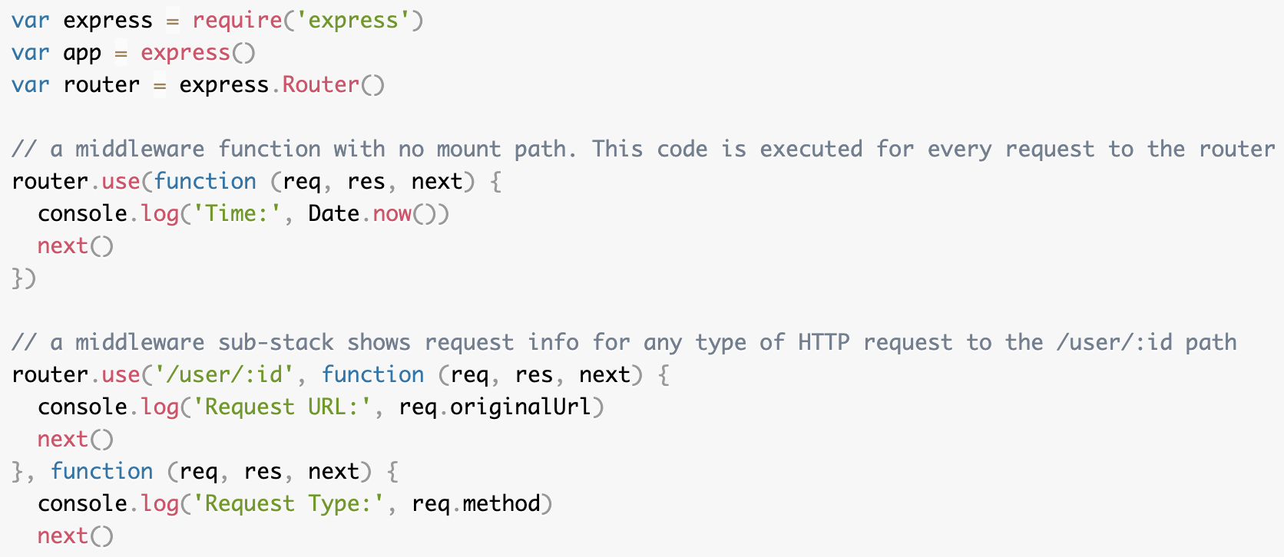
Router-level Middleware
Router-level middleware works in the same way as application-level middleware, except it is bound to an instance of express.Router(). The following example code replicates the middleware system that was shown for application-level middleware

Slide 15
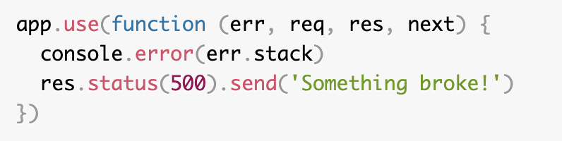
Error-handling Middleware
Define error-handling middleware functions in the same way as other middleware functions, except with four arguments instead of three, specifically with the signature (err, req, res, next)):

Slide 16
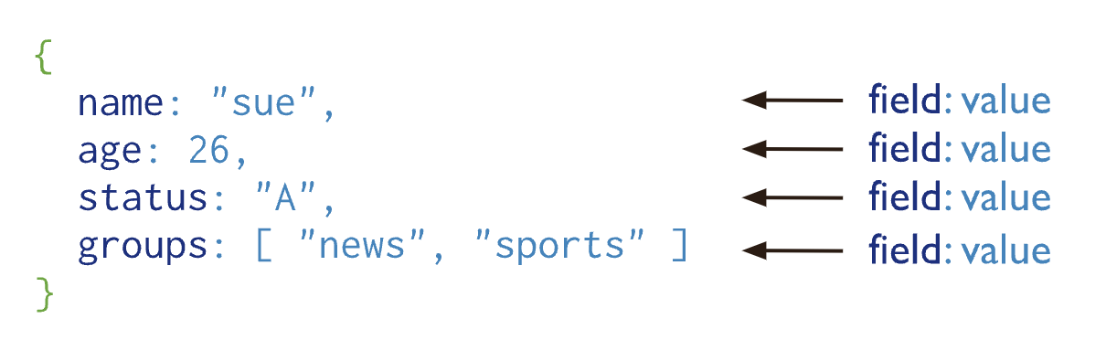
MongoDB - Document Database
A record in MongoDB is a document, which is a data structure composed of field and value pairs. MongoDB documents are similar to JSON objects. The values of fields may include other documents, arrays, and arrays of documents.
The advantages of using documents are:
Documents (i.e. objects) correspond to native data types in many programming languages.
Embedded documents and arrays reduce need for expensive joins.
Dynamic schema supports fluent polymorphism.

Slide 17
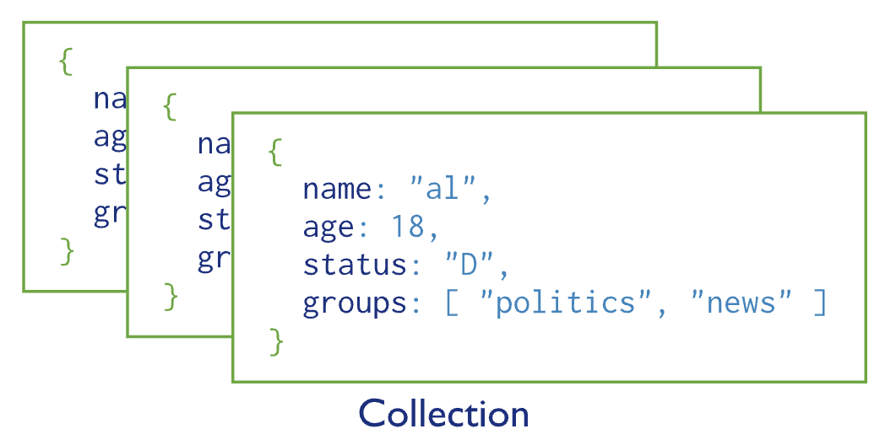
MongoDB - Fundamentals
Overview¶
MongoDB stores data records as documents (specifically BSON documents) which are gathered together in collections. A database stores one or more collections of documents.
Databases
In MongoDB, databases hold one or more collections of documents.
Collections¶
MongoDB stores documents in collections. Collections are analogous to tables in relational databases.
By default, a collection does not require its documents to have the same schema; i.e. the documents in a single collection do not need to have the same set of fields and the data type for a field can differ across documents within a collection.
Starting in MongoDB 3.2, however, you can enforce document validation rules for a collection during update and insert operations.

Slide 18
MongoDB - Atlas
MongoDB Atlas is a fully-managed cloud database that handles all the complexity of deploying, managing, and healing your deployments on the cloud service provider of your choice (AWS , Azure, and GCP). MongoDB Atlas is the best way to deploy, run, and scale MongoDB in the cloud. With Atlas, you’ll have a MongoDB database running with just a few clicks, and in just a few minutes.
https://www.mongodb.com/basics/mongodb-atlas-tutorial

Slide 19
Mongoose
We will use Mongoose ODM to access our library data. Mongoose acts as a front end to MongoDB, an open source NoSQL database that uses a document-oriented data model. A “collection” of “documents” in a MongoDB database is analogous to a “table” of “rows” in a relational database.
The very best performance can be gained by using SQL, or whatever query language is supported by the database.
ODM's are often slower because they use translation code to map between objects and the database format, which may not use the most efficient database queries
The benefit of using an ODM/ORM is that programmers can continue to think in terms of JavaScript objects rather than database semantics — this is particularly true if you need to work with different databases (on either the same or different websites). They also provide an obvious place to perform data validation.
Using ODM/ORMs often results in lower costs for development and maintenance! Unless you're very familiar with the native query language or performance is paramount, you should strongly consider using an ODM.
You don't need to know MongoDB in order to use Mongoose, although parts of the Mongoose documentation are easier to use and understand if you are already familiar with MongoDB.

Slide 20
Mongoose - Schemas and Models
Models are defined using the Schema interface
The Schema allows you to define the fields stored in each document along with their validation requirements and default values
You can define static and instance helper methods to make it easier to work with your data types, and also virtual properties that you can use like any other field, but which aren't actually stored in the database
Schemas are then "compiled" into models using the mongoose.model() method.
Once you have a model you can use it to find, create, update, and delete objects of the given type
Each model maps to a collection of documents in the MongoDB database. The documents will contain the fields/schema types defined in the model Schema

Slide 21
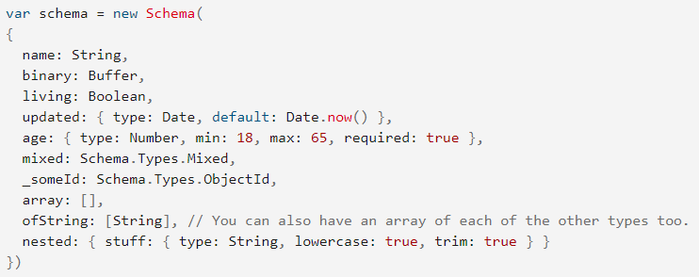
Mongoose - Schema Types
A schema can have an arbitrary number of fields — each one represents a field in the documents stored in MongoDB
ObjectId: Represents specific instances of a model in the database. For example, a book might use this to represent its author object. This will actually contain the unique ID (_id) for the specified object. We can use the populate() method to pull in the associated information when needed.
Mixed: An arbitrary schema type.
[]: An array of items. You can perform JavaScript array operations on these models (push, pop, unshift, etc.). The examples above show an array of objects without a specified type and an array of String objects, but you can have an array of any type of object.

Slide 22
Mongoose - Declaring Schema Fields
There are two methods for defining schema fields
1. Field name and type as a key-value pair (i.e. as done with fields name, binary and living).
2. Field name followed by an object defining the type, and any other options for the field. Options include things like:
default values.
built-in validators (e.g. max/min values) and custom validation functions.
Whether the field is required
Whether String fields should automatically be set to lowercase, uppercase, or trimmed (e.g. { type: String, lowercase: true, trim: true })

Slide 23
Mongoose - Schema Validators
Mongoose provides built-in and custom validators, and synchronous and asynchronous validators. It allows you to specify both the acceptable range of values and the error message for validation failure in all cases.
The built-in validators include:
All SchemaTypes have the built-in required validator. This is used to specify whether the field must be supplied in order to save a document
Numbers have min and max validators
Strings have:
enum: specifies the set of allowed values for the field
match: specifies a regular expression that the string must match
maxLength and minLength for the string
For complete information on field validation see Validation (Mongoose docs).

Slide 24
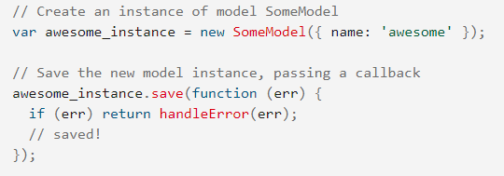
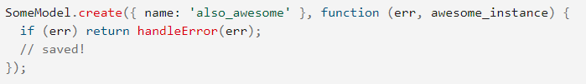
Mongoose - Models
Once you've created a schema you can use it to create models. The model represents a collection of documents in the database that you can search, while the model's instances represent individual documents that you can save and retrieve.
To create a record you can define an instance of the model and then call save(). The examples below assume SomeModel is a model (with a single field "name") that we have created from our schema.
Creation of records (along with updates, deletes, and queries) are asynchronous operations — you supply a callback that is called when the operation completes.
The API uses the error-first argument convention, so the first argument for the callback will always be an error value (or null). If the API returns some result, this will be provided as the second argument.

Slide 25
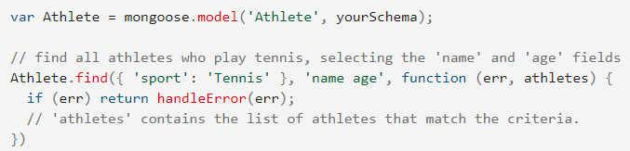
Mongoose - Searching for Records
You can search for records using query methods, specifying the query conditions as a JSON document.
The code fragment below shows how you might find all athletes in a database that play tennis, returning just the fields for athlete name and age. Here we just specify one matching field (sport) but you can add more criteria, specify regular expression criteria, or remove the conditions altogether to return all athletes
All callbacks in Mongoose use the pattern callback(error, result). If an error occurs executing the query, the error parameter will contain an error document and result will be null. If the query is successful, the error parameter will be null, and the result will be populated with the results of the query.
Not finding any results is not an error for a search

Slide 26
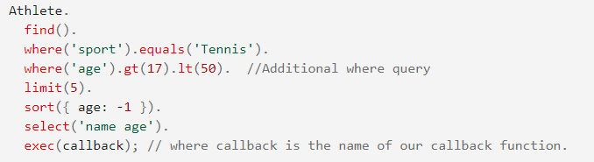
Mongoose - Utilizing where()
We can also perform a query with conditions using a where() function, and we can chain all the parts of our query together using the dot operator (.) rather than adding them separately. The code fragment below is the same as our previous query, with an additional condition for the age.

Slide 27
Mongoose - Additional query methods
The find() method gets all matching records, but often you just want to get one match. The following methods query for a single record:
findById(): Finds the document with the specified id (every document has a unique id).
findOne(): Finds a single document that matches the specified criteria.
findByIdAndRemove(), findByIdAndUpdate(), findOneAndRemove(), findOneAndUpdate(): Finds a single document by id or criteria and either updates or removes it. These are useful convenience functions for updating and removing records.
count() method that you can use to get the number of items that match conditions. This is useful if you want to perform a count without actually fetching the records.
For more information see: Queries (Mongoose docs).

Slide 28
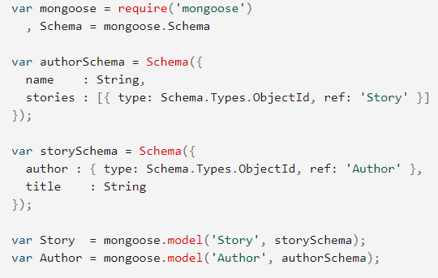
Mongoose - related documents (population) (1)
You can create references from one document/model instance to another using the ObjectId schema field, or from one document to many using an array of ObjectIds. The field stores the id of the related model. If you need the actual content of the associated document, you can use the populate() method in a query to replace the id with the actual data.
The following schema defines authors and stories. Each author can have multiple stories, which we represent as an array of ObjectId. Each story can have a single author. The ref property tells the schema which model can be assigned to this field.

Slide 29
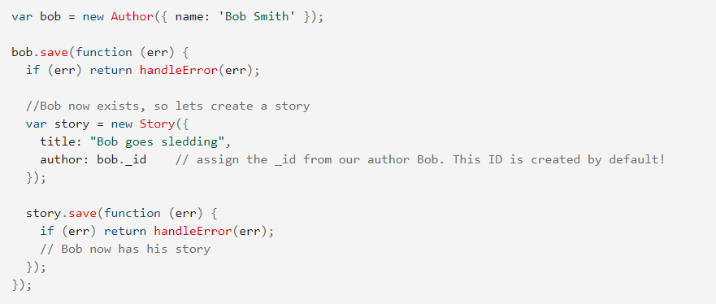
Mongoose - related documents (population) (2)
We can save our references to the related document by assigning the _id value. Below we create an author, then a story, and assign the author id to our story's author field.

Slide 30
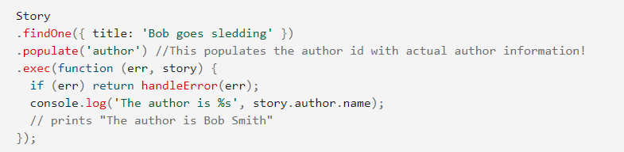
Mongoose - related documents (population) (3)
Our story document now has an author referenced by the author document's ID. In order to get the author information in the story results we use populate(), as shown below.

Slide 31
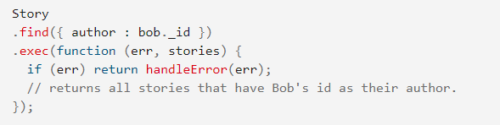
Mongoose - related documents (population) (4)
We added an author to our story, but we didn't do anything to add our story to our author's stories array. How then can we get all stories by a particular author? One way would be to add our story to the stories array, but this would result in us having two places where the information relating authors and stories needs to be maintained.
A better way is to get the _id of our author, then use find() to search for this in the author field across all stories.

Slide 32
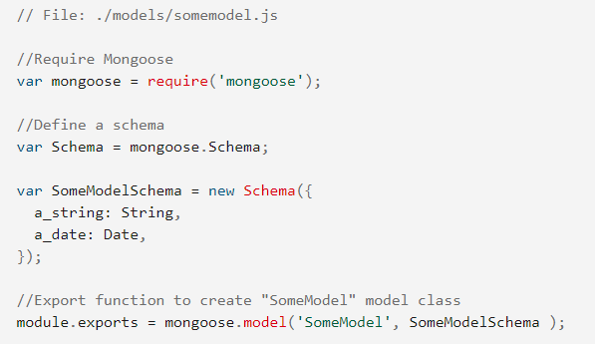
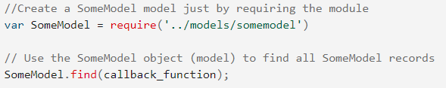
Mongoose - organizing schemas/models
One schema/model per file
While you can create schemas and models using any file structure you like, it is recommended to define each model schema in its own module (file), then exporting the method to create the model. This is shown below:
You can then require and use the model immediately in other files. Below we show how you might use it to get all instances of the model.

